Slide 1
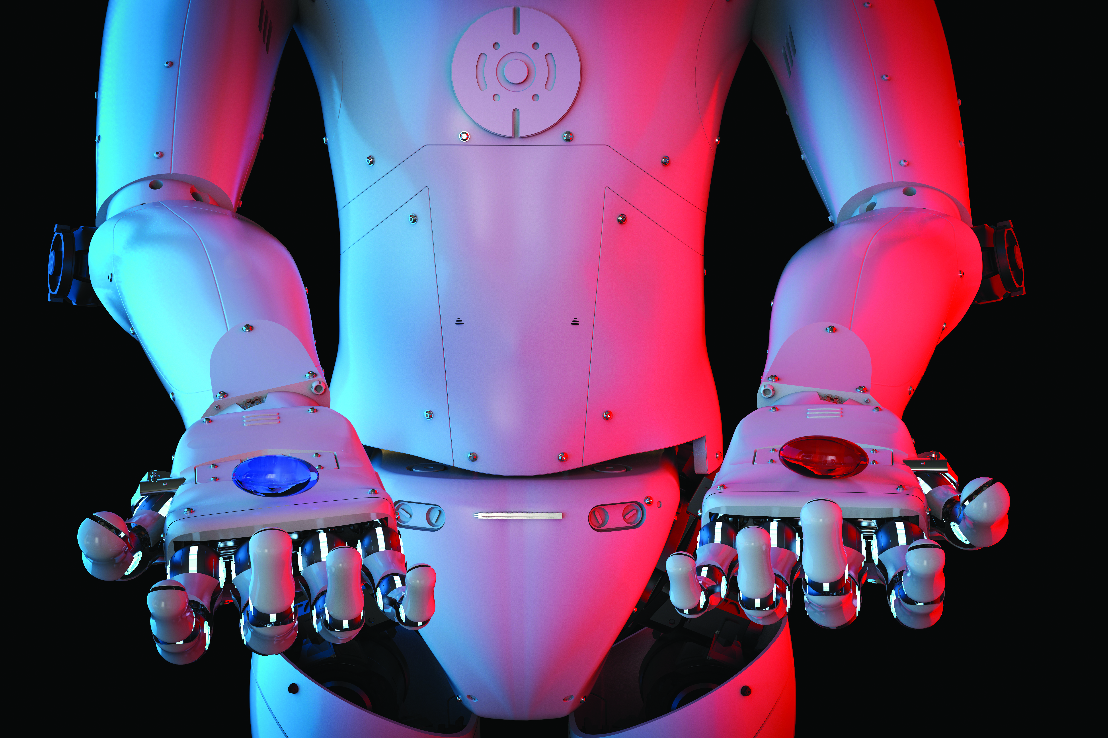
Embracing the Inevitable
How “Wireless” isn’t going way
Embracing the Inevitable
Why Wireless is NOT going anywhere
Notes:
First off Thank you for having me today.
The goal is to give you more of an insight into the world of wireless, how it works, why we need it and why its not going away. In short , Embracing the inevitable.
The reason for the title is to not be all pushy but to explain that this is actually a reality , its already here.
So again Thank you and hopefully I don’t put any of you to sleep.

Slide 2
Where did it all start
Yes that is me!
Notes:
1:40
You probably thought that I was going to explain where wireless all started, we will get to that soon but I thought I would give you a little info about me and lighten the mood a bit. I don’t think a lot of people here have a clue who I am.
As you can see I am the one doing the “nerdy” presentation and it really is something that fits right in for me.
I got my first computer a TI-99 SLIDE in grade 3 so I was…… 8 or something like that. By grade 4 I was programming little games in basic programming, I actually wish I could show people , but they were horrible. Text based games and then I found out how do some graphics. SLIDE By grade 5 Apple 2’s hit the scene at our school and I spent loads of time playing and programming. So far as to try to make a checkers game , but after discussing with my teacher numerous times, he decided that he would build it and I was cut out of the loop! LOL. Who knew.
But then in sharp contrast I do understand the mechanical side , because all computer nerds become drag racers right?
By 19 I was building my own cars and built my own engines , and drove bracket cars. Super expensive sport and not usually supported after the first kid pops out. But now that my kids are getting closer to driving they are each talking about building a car. A Nova and a Camaro. We can talk cars later if you want. ☺
So to say I have been doing this for a long time is an understatement.
I know I look 25 but I have actually been in this industry for 17 years now and been designing electronics for 20.
My HVAC career started when Tom Hermann and I started HBX Controls in 2003 after a little bit of a rocky start. Now I didn’t always look this professional. I used to skateboard and snowboard a lot. So when tom first contacted me to make a board for him………..
The point of all that introduction is to show you I am an actual human because once I get started on the technical side you may not believe me anymore. ☺. But there is a lot of material to cover, so I will do my best to make sure its understandable. One of my main goals is always to communicate in a way that people understand what I am trying to say easier.

Slide 3
Where do you fit in?
Notes:
3:20
I let the whole sound play for dramatic effect.
We all know what that sound is, well I guess most of us do. There is a few young ins that may have never used a modem before! I threw in that sound because I remember the first time I went on the internet and heard that sound. Crazy times, with Netscape and AOL. And the dawn of the internet!
Ok, now please humor me in this little interactive section. So I need everyone to play along, its not going to turn into something weird, where you discuss things with everyone, so don’t worry. Its will be easy.
Whoever has a cell phone with them , raise your hand. Come on , everyone needs to participate
Ok. If you have a phone that has more than 1 camera on it, this could be front and back or double in the back or whatever. Put your hand down. .
If your phone has a screen as close to the size of your hand, please put your hand down.
If your phone DOES NOT have a hardware keypad, meaning it does not have actual buttons. Put down your hand.
We are getting down to the nitty gritty here.
If you have “FLIP PHONE” KEEP YOUR HAND UP. Everyone else put down your hands.
For those of you with your hand still up , firstly you really need to get a better phone and secondly you are not going to want to hear anything I’m going to say today. Just kidding!
No its kind of just to show how far we have gotten already. Those with a “smart phone” are able to take full advantage of all we are going to talk about today. Those with a flip phone, well, you really need to get on the bus, although the bus has already started moving.
TELL THEM WHAT PHONES I HAD. I actually had an original Iphone that I bought out of the states when they first came out.

Slide 4
What the heck does wireless mean?
Wireless.. It’s a highly technical term used when you have communication between devices ….. Without wires.
All Wireless systems use Radio Frequency to transmit signals. (RF)
That’s what makes them wireless
Wi-Fi
Bluetooth Le and Classic
ZigBee
LoRa
Z-Wave
SigFox
There is too many to put up here. ☺
Notes:
5:00
I think that there is a couple different terms, that mean different things, to different people. This wouldn’t be the first term to do that but lets try to clear the air a little bit here. But first a funny story.
Funny story, literally a couple weeks ago my wife was just talking about this presentation, trying to help me out a bit said “ what is Wi-Fi”. So I thought a bit and started with one of my crazy analogies, like well, think of your house as your computer and the mall is the internet , I started losing her at this point but I pushed on, and I said you could take city transit , which would be like a wired connection , or you could rent a helicopter to come pick you up. Clearly the helicopter would be a lot easier to do than city transit and you don’t have to follow the roads in the helicopter.. Then she said, ok so can take the helicopter anywhere else? I was like what?? No you can only go the mall with it right now. LOL. So you see it might not be that simple.
Read the first point, this seems pretty ambiguous but that is essentially what it is.
This communication signal can be a simple as a radio station putting music on top of the RF signal like AM or FM radio
Or wifi or Bluetooth or any others.

Slide 5
How does the signal work?
Notes:
6:40
So lets step back a tiny bit and go over some fundamentals of Wireless. I know , I know , im not going to spend a lot of time here and I promise you not to get too technical but this may help you understand a little more about wireless.
For a wireless signal to start at one place, with a message , fly through the air to another place, you need 4 parts.
You need the message
You need a carrier
You need something that smushes the signal and the carrier together (Modulating)
You need to push it out into the air
The first part is AM modulation . It uses amplitude modulation (AM), basically changing the height of the signal to get the message across.
The middle is FM radio, usually higher carrier frequency and the modulation(how they set the signal on the carrier) is also different. Its frequency modulation(FM), the frequency changes based on the message being sent.
The last is the world as we know it. Placing a digital signal onto the carrier. And this can be done at very high frequencies, and thus faster information flowing back and forth.

Slide 6
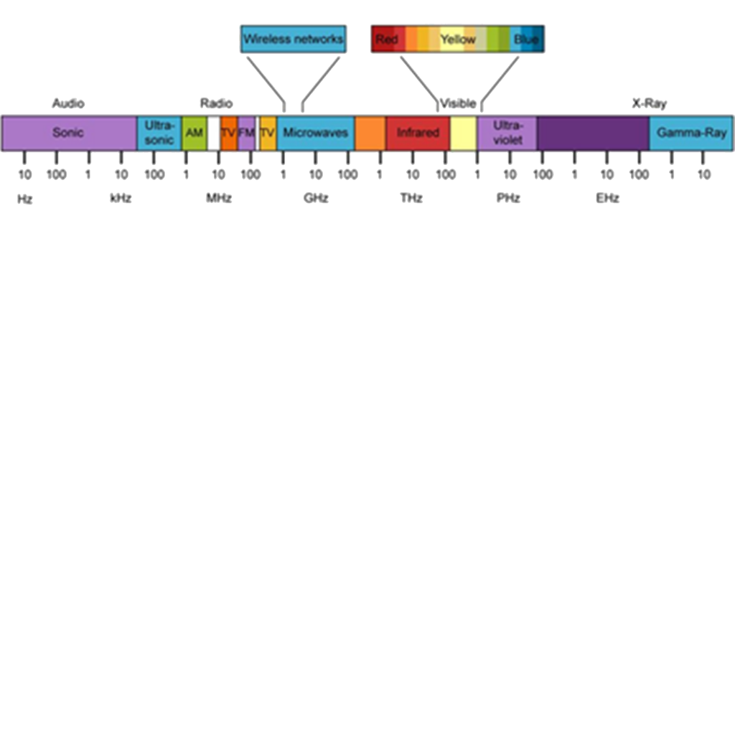
Wireless Spectrum
What happens with so many devices everywhere.
You have a lot of (Collisions) and “background noise”
Try using Wi-Fi and then turn your microwave on
Remember Buffering ☺
Notes:
8:20
READ POINT 1.
We are all worried about how much wireless there is around us. The wireless signal that we mostly use right now is 2.4GHz but its moving to 5Ghz, not to be messed up with 5G cell networks that you are starting to hear about lately.
The 2.4GHz space is getting crammed full of devices , the more you have in one area the more collisions and background noise you have. This causes re-transmisions and loss of information eventually. Loss of information is bad for everyone.
Its like this. If I started shouting my name out, trying to tell the guy way at the back , he could probably hear me properly. One because I’m loud but the other is there is nothing interfering with me talking or him listening for that matter.
But then add 2,3,10 more people doing the same thing, trying to shout their name to other people in the room , the messages would stop getting to where they are going. The person listening could not hear anymore because of all the other people shouting names. Fortunately technology has become very good at weeding out all the noise and just listening for specific signals or specific topics and collision avoidance methods.
As we move across this spectrum The smaller the frequency , as it moves towards gamma rays the easier it is to get in between things. Think of it like this , if the signal is a meter wide and it tries to fit through a closed door , the signal will degrade from hitting the door and not be the same on the other side, but if the signal is small enough to fit through the cracks , under or on the sides of the door then it will make it to the other side un scathed. Message delivered! So frequency does matter in all of this as well.

Slide 7
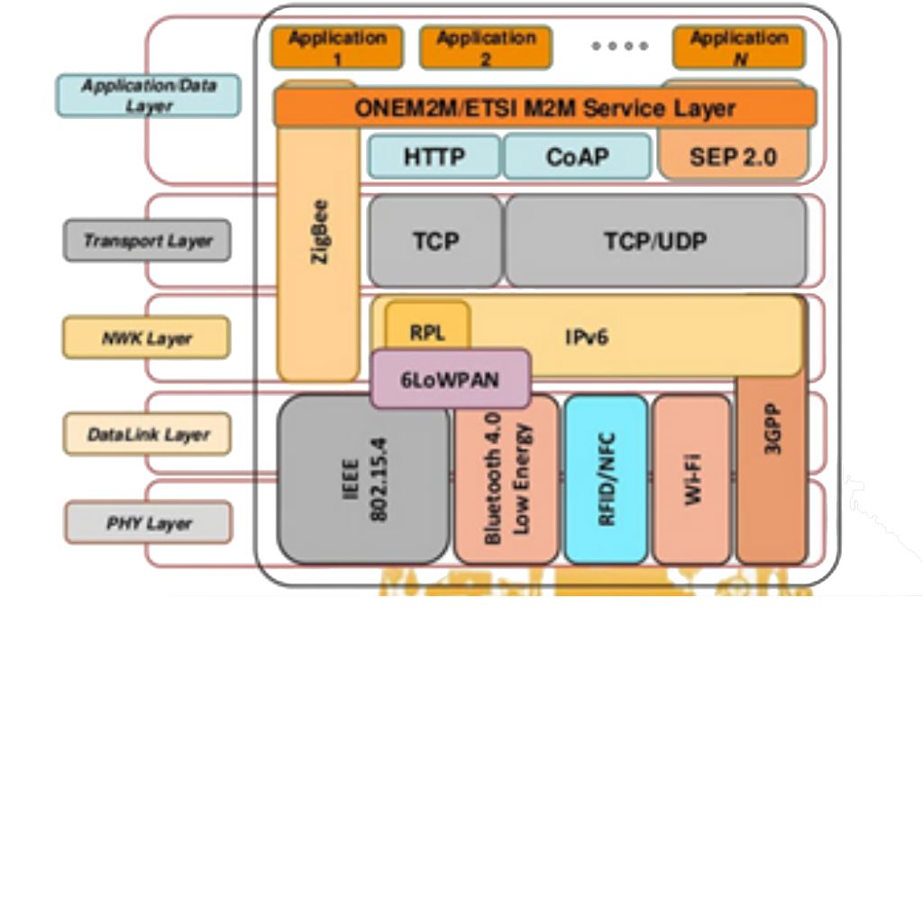
Protocol
The terms Wi-Fi , Bluetooth and ZigBee use “wireless” technology to send a specific protocol.
This leads us down another path of …… What is a protocol?
Notes:
10:00
OK….. Wireless has become synonymous with Wi-Fi to most but Wi-Fi is just a wireless protocol as I will point out in a bit.
A protocol has many different aspects. As you can see here there is a lot of layers. I’m not going to bore you with all this but I just want you to see that all of this sits behind the “wireless” portion.
All of these layers have to happen so that when you send “Hello World” at your end , that I receive “Hello World” on my end.
There is physical layers. The hardware that send the data out like Wi-Fi, Bluetooth, ZigBee or whatever
You also have network layers ,that’s the modems and router stuff
transport layers the “internet language translation” the complicated stuff,
then the actual application layer which is your program on your chip.

Slide 8
Protocol Example
Step 1 >>> write some code to do something on your device.
Step 2 >>> translate that into the “internet” language usually TCP/IP
Step 3 >>> combine the translation into a network layer so it knows where to go , connect to router at this point
Step 4 >>> get it onto the internet with WIFI and your hardware
Step 5 >>> Do it all in reverse at the other end. ☺
Notes:
11:40
I will point out that step one is actually the hardest.
You need to come up with the idea to be able to do anything.. ☺

Slide 9
Wireless - Wi-Fi - Apps
Notes:
13:20
The interpretation of how people think , is best left to phycologists , but there is an interesting phenomenon that happens when you mention wireless to people.
In most cases the person included Wi-Fi into their thinking when you say wireless and then they usually take it one step further and think that if its Wi-Fi then there is an App for that.
They are literally not far off in their thinking but these items are not all joined at the hip.
What that means is yes, you do need “wireless signal” to create Wi-Fi, but just because something has Wi-Fi does not necessarily mean there is an app for that. But the terms , more and more get squished together. And literally that is OK, at least with me. Because once you know how people interpret a term , it makes it easier to speak to it.
Just know this is not a bad thing to have happen, but they do mean different things.
So most people think Wi-Fi stands for wireless fidelity or something like that, but that could not be more wrong. Its literally just a made up term. A marketing word essentially that just stands for the IEEE 802.11b protocol. But who wants to go around saying, hey do you have any IEEE 802.11b around here I can connect to. I don’t think so. Wi-Fi is a much better tern to use.
We will focus mostly on Wi-Fi and how it fits in our industry. Wi-Fi is definitely the best know term, we all have it in our house, in our offices and if you go to Starbucks guess what they have it there too.

Slide 10
But what does Wi-Fi really mean?
Notes:
15:00
Wi-Fi gives us the freedom to get rid of the wires. Walk around the house with your cell phone, facetime someone, read emails, take a picture of your house and send it out instantly to all of your friends!
Some of these , yes you can do with a wired connection, but , lets look back for a minute , who here remembers the first time talking on a “cordless phone” ? I do . I bought one specifically in high school to talk with my girlfriend in private. Someplace not 4 feet from the phone in the kitchen, or 10 feet if you had one of those really long coily chords attached to your phone. You know the ones they were on the same phones with the rotary dials.
But I think you get what I mean. Things like next gen cell phones and next gen cell signals will take this even farther. We will be able to have signals everywhere.
This is literally where companies are moving right now. This industry is humungous.

Slide 11
Wi-Fi is not the enemy
Notes:
16:40
This is the enemy, wiring!
Our expectations of how we set devices up has changed. Its Apples fault, blame Amazon , I don’t know but its changed.
Homeowners expect , even contractors expect, to be able to click a button and they are connected. We get attached to the “cloud” instantly.
Its literally not that simple but I do think it will get there, sooner than later. Simplicity in a lot of cases ,drives innovation. Which is always good thing.

Slide 12
Typical Network
Notes:
18:20
So here we have typical network. Home or work it doesn’t matter.
There is laptops on it, smart phones , usually a bunch especially if there is kids around,
Maybe a desktop computer
And then we are starting to see these little nodes as they are called , or little devices that are on our networks , looking at what we are doing or what is happening around us.
In this case I put a water sensor, this could be inline or on the floor, room sensors, and sensors that know if we are home or not.
But the key point here is not all of that, but its the little “cloud” in the middle of it all. This is the new world as we know it. All of these diagrams , no matter what they have on them , have a cloud in the middle. That is our connection out to everything else, and in some cases, others connections into ours.

Slide 13
Wi-Fi Progression
Notes:
20:00
The 2 biggest “wireless” terms we hear are Wi-Fi and Bluetooth. Your phones have both of them and they are used for different things.
I remember a vendor from an electronic company giving me a box the had Bluetooth in it. They wanted me to see if I could use it in anything. At the time I was designing battery analyzers that were used in the us military so I did not see a fit at that point. And to try to implement something like, Bluetooth 1.0, back in the year 2000 would have been crazy to do. Its still hard now!
Bluetooth is primarily used to connect close items together, your watch to your phone, your mouse to your computer , stuff like that.
There is also a difference when you want to create different styles of networks with items. We will talk about this a little later.
Does anyone actually remember Wi-Fi back in 1999? I would like to see a show of hands. I don’t.
It wasn’t until like 2003 that it really started to proliferate the world. We have already built everything with hard lines, and as you know the world can be a stubborn little place.
Faster, faster faster.
Who here gets mad at their cell phone when a picture does not load fast? Come on we all do it, I did it this morning.
As we do more things online this aspect of our lives becomes way more important. We want as much information as we can get our hands on and we want it now!
READ THE SLIDE and DESCRIBE IT

Slide 14
Notes:
21:40
Ok another funny story.
We were having diner last Friday with a friend and I was telling her about doing a presentation and such, she asked what it was on and instead of saying wifi and the internet I just said IOT. I made a big assumption here. Then both my wife and friend said “what the heck does IoT mean”. So I confidently say , it means Internet of things. Now at this point I would have thought they would have said oh yea I've heard about this but they both actually started laughing at me and said, you just made that up, seriously you made that up. I was not impressed. But it does make for a funny story and good intro into our next section
THE INTERNET OF THINGS.
So before that day I actually thought You literally have to be living under a log if you have not at least heard this term before. But clearly I was wrong.
The Internet of things or IoT for short means a lot of things to a lot of people , but here is description that I found that sums it up.
The internet of things, or IoT, is a system of interrelated computing devices, mechanical and digital machines, objects, animals or people that are provided with unique identifiers (UIDs) and the ability to transfer data over a network without requiring human-to-human or human-to-computer interaction.
The key point is that they can talk to each other and gather info without someone directing what they are doing. Very interesting.

Slide 15
History of IoT
1926 - "When wireless* is perfectly applied the whole earth will be converted into a huge brain, which in fact it is, all things being particles of a real and rhythmic whole.........and the instruments through which we shall be able to do this will be amazingly simple compared with our present telephone. A man will be able to carry one in his vest pocket.“
1999 – IoT phrase was coined
2008 – IoT became a reality, when more “things” were connected to the internet than people.
Notes:
23:20
One of my favorite people in history, the inventor of AC voltage Nikola Tesla. He said …. READ FIRST PART NOW>
I like how he said vest pocket. Who here is wearing a vest? He totally got part that wrong.

Slide 16
API
Application Programming interface
Things that talk to other things without speaking the same language.
Used in “cloud” based devices
Very easy to gather information from multiple sources
Better than application specific protocols
Yes I really said that
Notes:
25:00
Consumers don’t want 20 apps for their devices, One for each device becomes cumbersome, so how do we over come that.
Well there are companies that would like everyone to standardize on a protocol , or method of transportation. I say humbug to that.
I feel that we have blown past that as manufacturers, as consumers, and as the technology has advanced that now our apps can basically ask other apps for information.
You tell me which is easier?
Start by “being part of an association”
Have your devices certified for that interoperability, make sure they talk properly and message properly.
Then use this specific protocol and transmit and receive to your devices
Then put that information out with that protocol that needs to be interpreted by wherever you were going to send it in the exact same manor.
I get why these protocols were made , I get it , I really do , there was too many proprietary protocols out there. Way too many.
And the way devices used to connect, there needed to be some standards, but devices are not being connected that way anymore.
the way everything is connected now , everyone can still use their own proprietary protocol to communicate to their own servers, or to the cloud or whatever
Then they open up a backend of their server so that other devices, or apps or systems can just ask for the information they want. The API is way simpler. And as more IoT comes together , there more information needs to be stored, and guess what ,that is on servers somewhere. Its very easy to ask for this information. Companies like weather stations and stock markets and others have been using API’s for a very long time.
Apps and programs already communicate from API’s. Its is very easy to add a sensor or sensor network to your building or home and then instead of needing those devices to talk to each other directly on the same protocol as your other devices already in the building, your BMS or app or sensor can just talk to the server of those devices and then just grab the information that they need.
Way easier , than getting all your devices using the same protocol, because what if they don’t make new devises that talk on your older protocol?

Slide 17
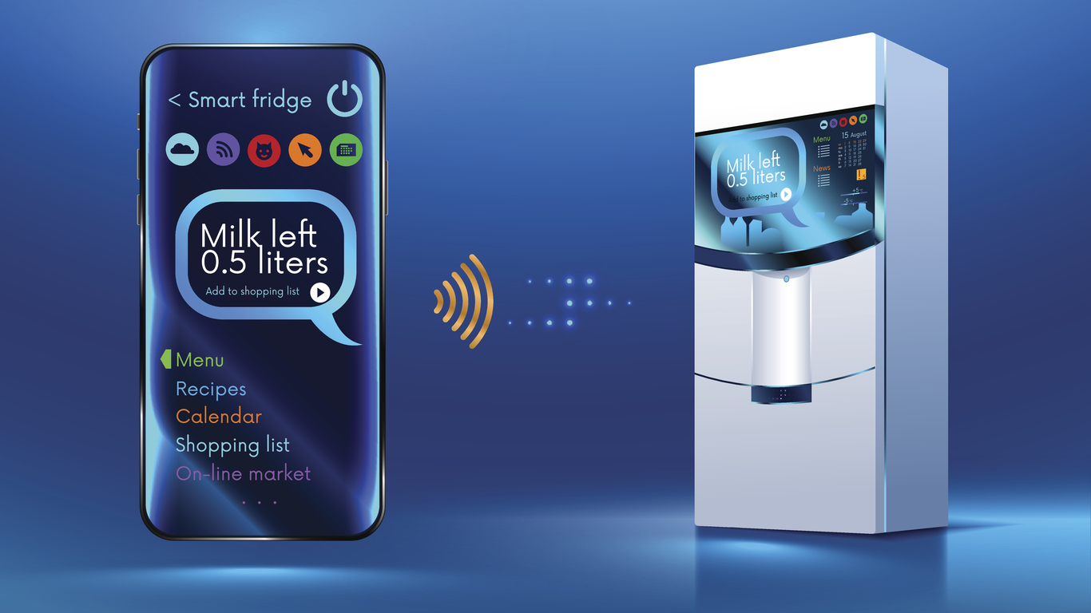
Internet of Things
What does IoT mean to you?
Online fridges , online toasters?
HVAC equipment, boilers, valves, homes?
Alarms or online cameras
How far does the progression go?
Who ends up with all the information.
Google bought Nest for Information. Information is king now.
Notes:
26:40
Its really all of the above. Read the Slide here
Take a look around the room, you will now find more than one vendor with Wi-Fi access and an app, And each year it will get more and more.
This is really being pushed by us. We want information, we don’t want to go the jobsite , if we can just adjust a setting on our phone. Why go, problem fixed.
How far will this go.
We all have stories about , you just sitting around the table with a phone here or there and all of the sudden Siri pipes up and says “I cant find that on the internet”. Or your Echo says “I put that on your reminders!”
Everyone says “what”? No one was even talking to these devices. But are they always listening?
Ever get those random emails ,FB messages or popups that show you exactly what you were talking about the day before? Yes you have. Its creeeeeeepppppyy!
All these guys want your information. Really bad. Like really bad. They will do almost anything under the law and sometimes not , to get it.

Slide 18
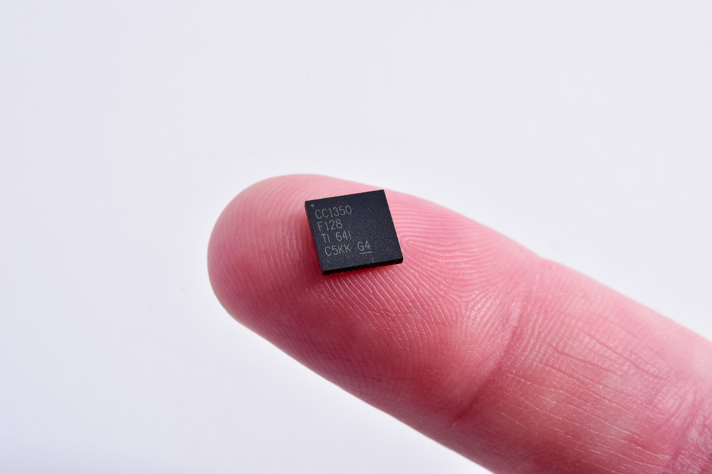
Size does matter!
Notes:
28:20
IOT is only now becoming bigger because technology has caught up. Ideas always supersede technology.
When a chip that is this small can do everything , well , now we are getting somewhere.
This chip literally has everything you need to get on the internet except an antenna. CLICK HERE Which as you may or may not know can be put right on the printed circuit board.

Slide 19
$121 Bln industry by 2021
Notes:
30:00
Industries are using IoT to make their plant more efficient With real time feedback for EVERYTHING you can make a lot of decisions and very informed decisions.
Appliance makers are putting connectivity in everything.
Our cars are going to start driving themselves.
Is it worth all the hype. We hear the term loosely thrown around but the people who coined it , I think hit the nail on the head when they called it the Internet of things.
Because the way it looks now ,it will be everything.
I often tell people who complain about the world and how “electronic” it is that, well , its too late. We wanted easier, faster , better, well this is exactly how we get there.
Some of the biggest companies in the world have bet big time on IoT, Amazon, IBM, Cisco, Intel, QUALCOMM and then there is thousands of smaller companies that have joined in. there is a lot of money to be made. A LOT
READ SLIDE NOW
Look at a couple of the key ones, Utilities, goes form 7 to 40 billion, manufacturing, 10 to 40 billion, transportation, 10 to 40 billion. Its crazy.

Slide 20
20 Billion units by 2020
Notes:
31:40
How does the money spent translate into “number of things”.
Its literally insane to see the progression , its starting to look like an exponential graph.
2014 was 3.8 billion
2018 was 11 billion
2020 is shooting for 20 billion

Slide 21
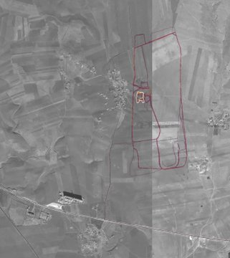
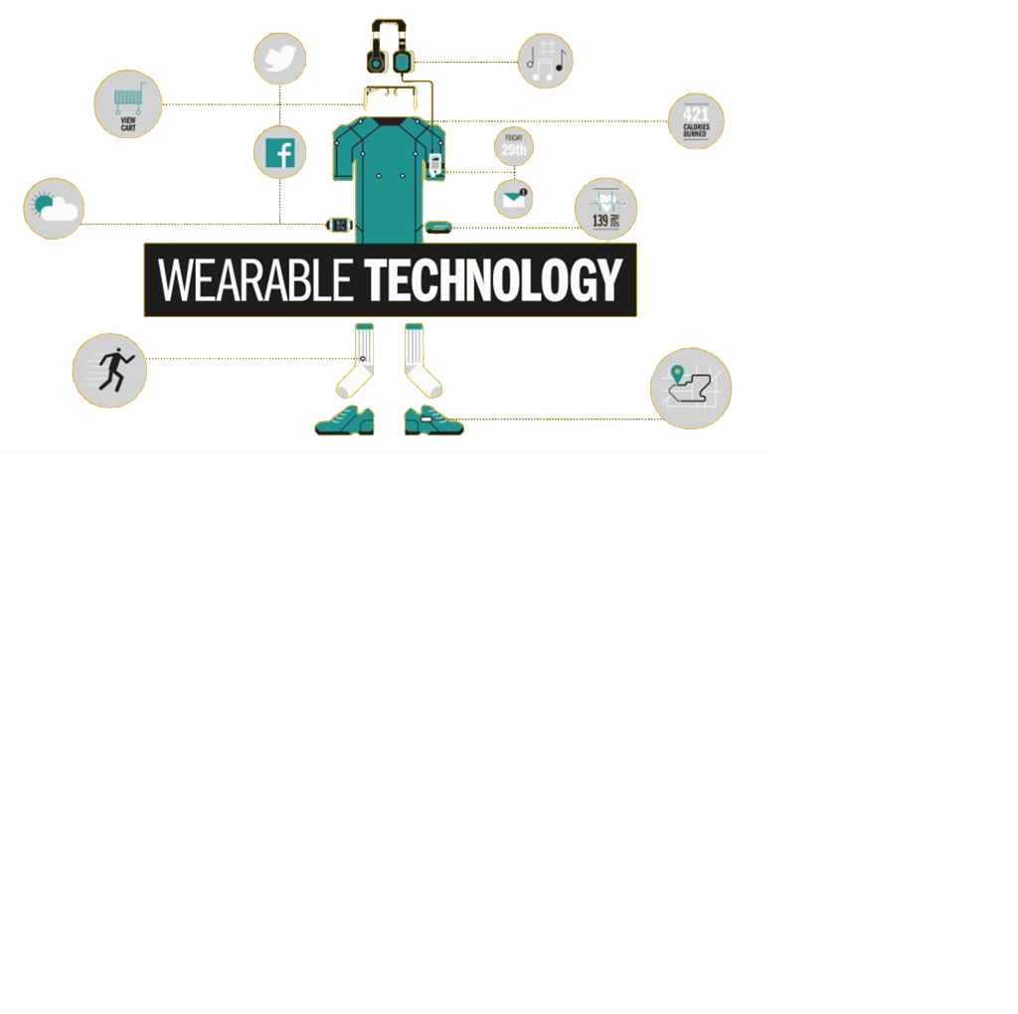
Everything talks to Everything
Apps
Notes:
33:20
I always like pictures. I think it because I like to point and move my hands a lot, but lets see some items that are entering our IoT world already.
Cars , that’s an obvious one.
Watches, or fit bits?
Who here joined the fit bit revolution , take a look at the information they were able to get from fit bits! SLIDE
This is a picture of the tracking data from fits bits and other step counting devices in a war torn county that I don’t think people realized was even possible , or even going anywhere for that matter, until it was too late.
Now not any normal person can just figure this out , but there is definitely some smart people in this world that could use this kind of information to do some not so good things.
This picture literally shows the running routes of soldiers. And they all come back to a central point, I wonder what is there?
Wearables is the one that interests me. It can show some interesting things, I have seen shirts with chips woven into the material.
But the concept is still a little crazy to me. I get that its coming , actually its already here but who needs all this?
Why do we need this. I think that socks are already expensive enough but if they start putting chips and wireless in them …. Well.. ☺
READ SOME OF TH SLIDE, emails, heart monitors, step counters, gps tracking, calorie tracking.
Home appliances and lighting is other IoT spectrums.
Manufacturing, health care
But what does iOT mean for us as an industry.

Slide 22
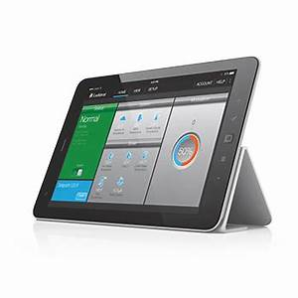
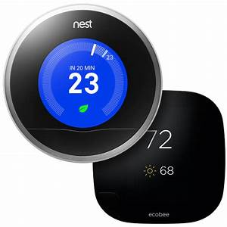
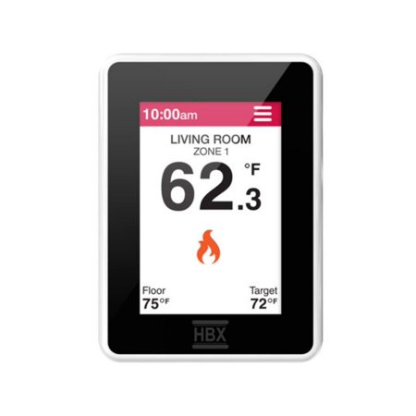
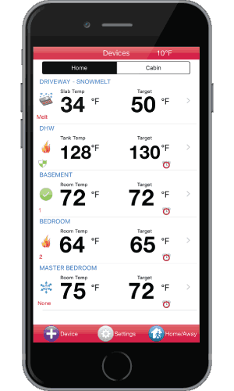
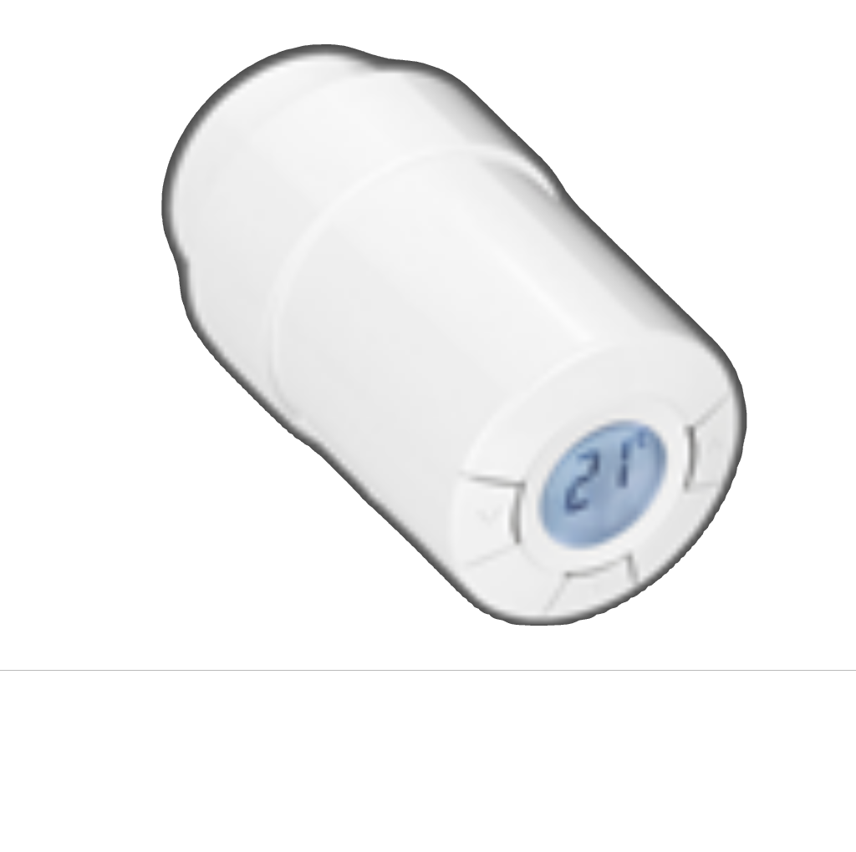
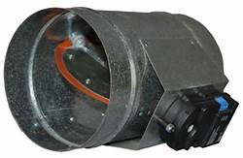
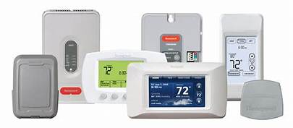
IoT and HVAC
Thermostats
Valves
Boilers
Zone Controls
Dampers
Sensors
All kinds of sensors
Notes:
35:00
READ THE SLIDE
And actually these are all items that are out in our industry today.
We are starting to put everything on Wi-Fi so that we can see it on an APP.

Slide 23
Where does it lead

Slide 24
Boiler Temperature
DHW Temperature
Heating BTU’s
Room Temperatures
Room Air Quality
Leak detection
Notes:
36:40
Iot is literally changing the landscape of how we think, do business, interact with eachother and everything around us. Lets not be fooled into thinking this wont happen. It will.
Sensors on devices like , hot water tank and boilers. CLICK
Sensors on cold and hot water lines , could be for Heat metering as well. CLICK
Thermostats and possibly other sensors like CO detection or air quality sensors. CLICK
Their could also be motion detection so that google knows when you are out shopping. ☺
Sensors on the heat emitters like radiators or zone dampers in air situations. CLICK
Having all of these sensors or IoT devices helps to give a good picture of your system. But only looking at each individually your definitely don’t see the same picture.

Slide 25
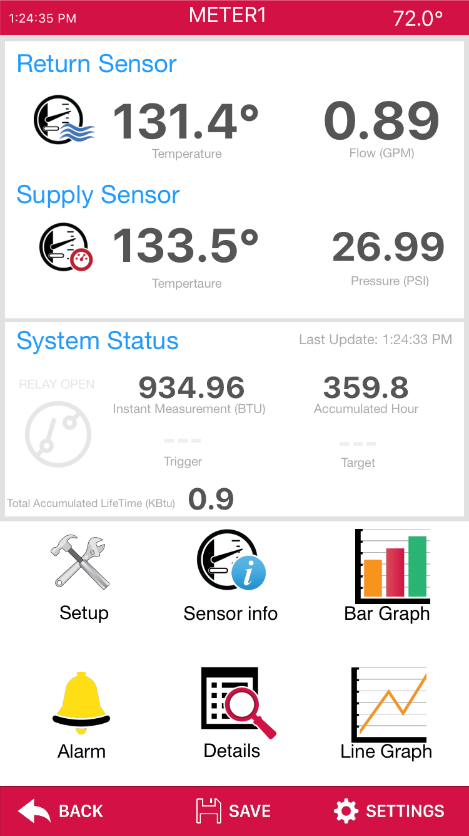
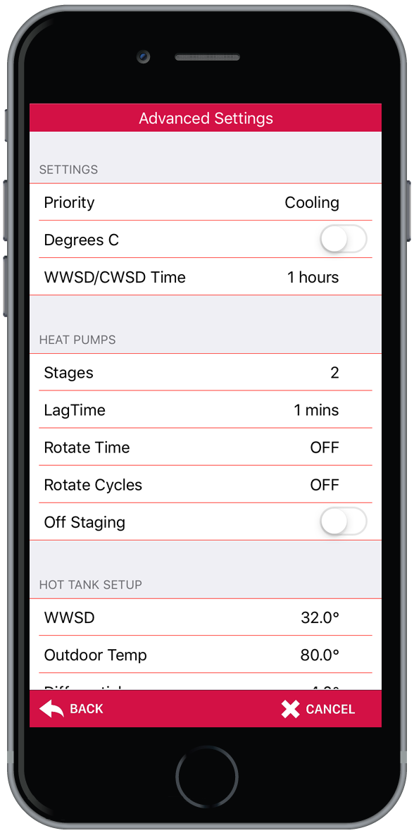
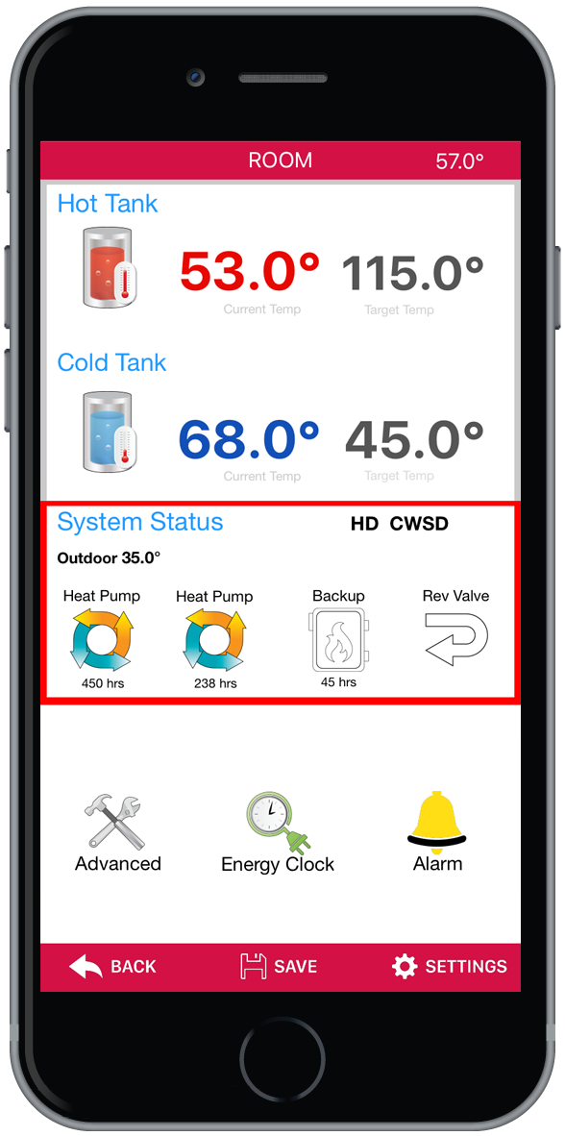
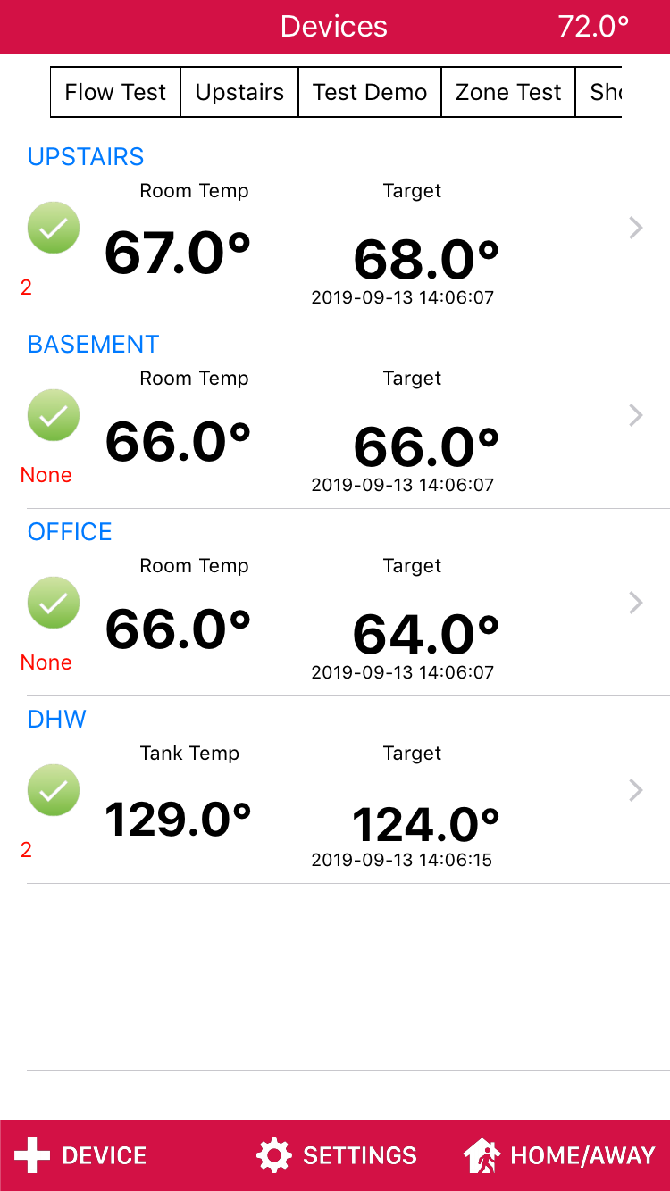
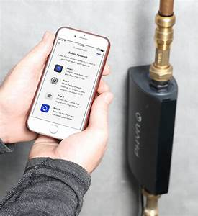
How does IoT help HVAC
Everything at your fingertips
Change settings on the fly
without being on site
Way easier to troubleshoot
You know before your customer does
Flow, pressure and leak detection
Custom alarms and emails
System overview in one glance
Devices are getting easier and easier to install and setup
Notes:
38:20
Anyone remember the old yellow pages add?
Let your fingers do the walking. Well its so true when you can see and manipulate controls, in remote locations.
Setting up the controls with alarms, is another big point, we are not always on our phones, well at least you shouldn’t be, but getting notifications , either through an app or email is essential to knowing problems before your customer does.
How comforting would it be if you called your customer and said, I noticed something deteriorating on your system. I'm going to come by and replace a couple items before something catastrophic happens.
I know it sounds a bit cliché but, customer expectations are getting higher and higher. They know this technology is out there.
Leak detection is becoming huge , huge! Insurance companies are starting to give homeowners rebates base on having these devices in their homes.
Adding these devices is easy with Wi-Fi, you will find that running a wire to these devices almost defats the purpose as they may not be as easy to get to. They also need to be on the net so that they work properly. If they can send alerts , they need to be connected, if they need to communicate with an App , they need to be connected.
So Wi-Fi for IoT is pivotal, to get into areas for these sensors that we may not be able to otherwise.
Water metering in your houses is already connected, you may not know it but it is.
Next generation of Heat metering is also coming to north America. Energy prices will continue to climb. As we strive for more Green alternatives and environmentally friendly solutions, over use and abundance will go by the wayside. These will be IoT devices.
9) So as an example We recently installed a bunch of heat meters in a building in calgary. These devices notbonly give us insight into the suite heating but so much more. We can see leaky valves, people who obviously use the windows to cool the suite instead of the thermostat, building pressure fluctuations from floor to floor, boiler temperatures flow rates. We have an entire building heating picture. Not just boiler temperature and maybe that a couple pumps are running. It’s a full picture.

Slide 26
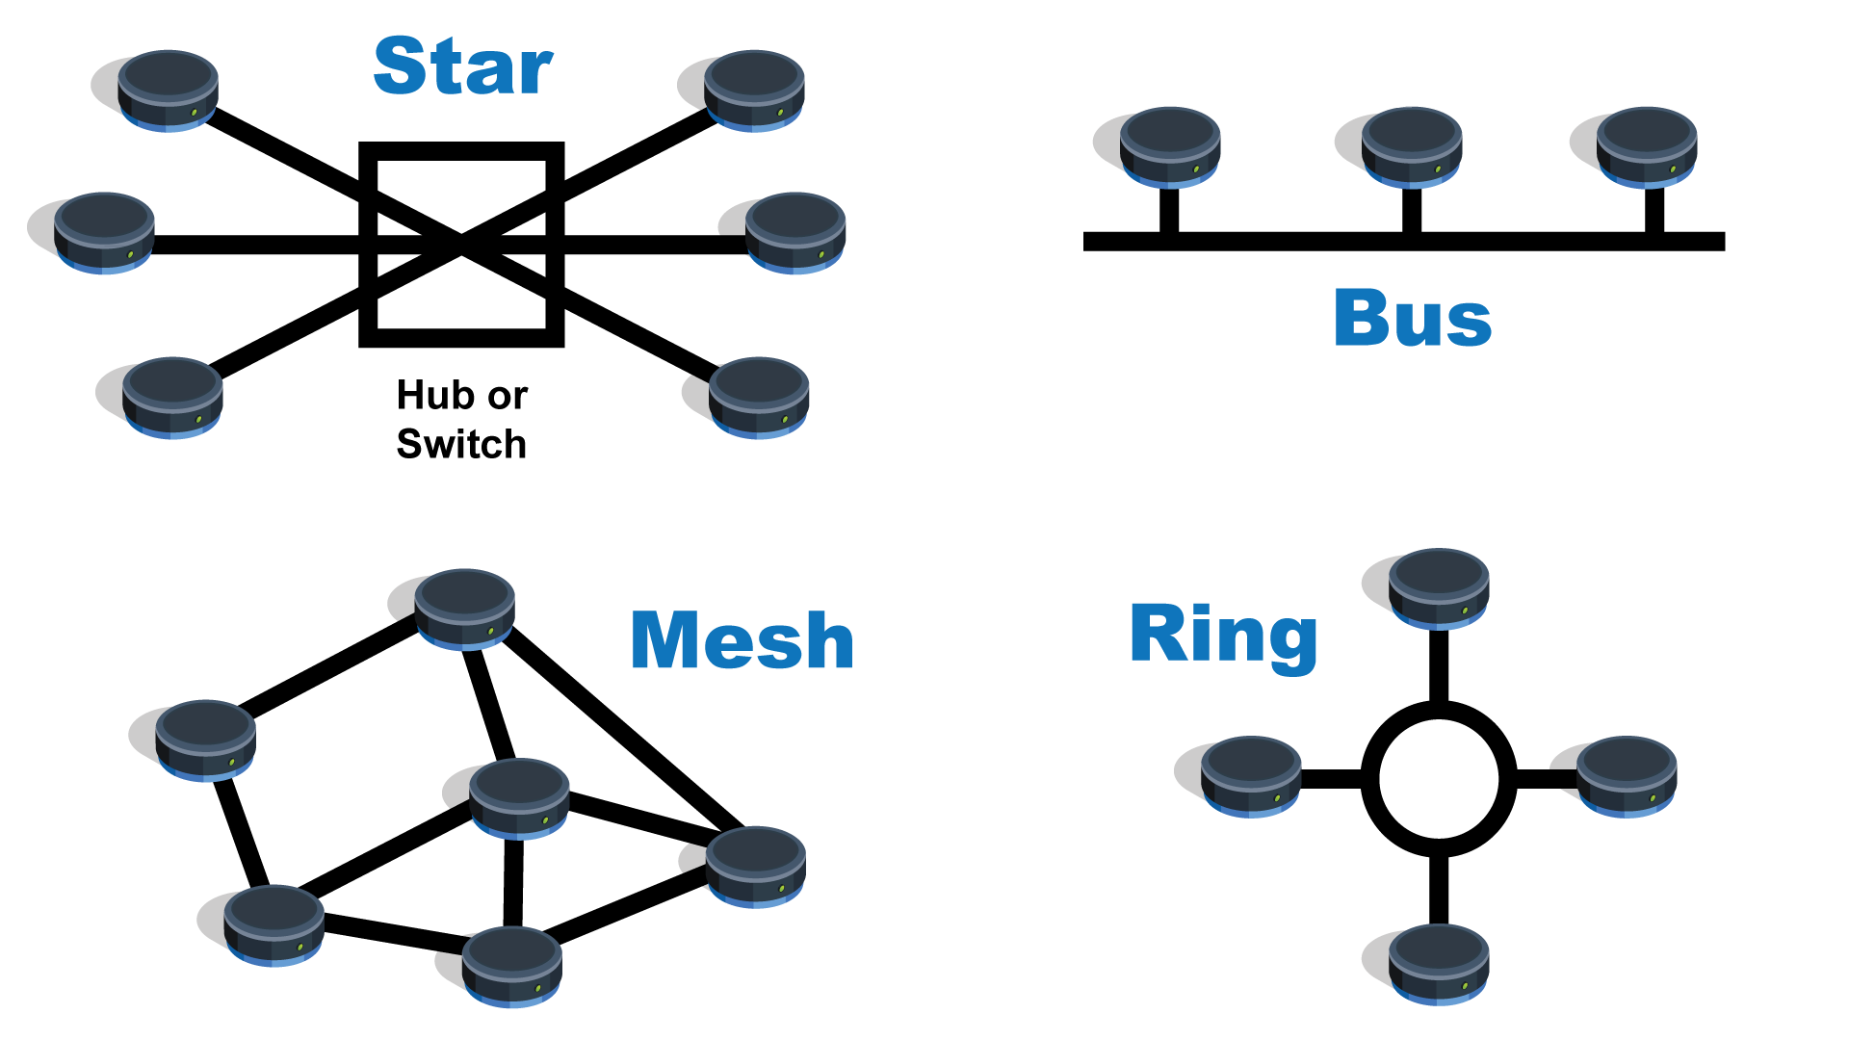
Network types
Star – Each item must talk to a central point to talk with any other items
Bus - This is typical LAN connection in your office.
Mesh - all items can talk with any other in the network directly, faster and best for hopping
Notes:
40:00
Creating a network for an area is becoming more and more needed. As we put sensors everywhere to collect data , that data needs to get back to the “brains” so it can be used to do something.
Being around for awhile I have seen things like ZigBee come on board , LoRa and others and then watched the Big 2 , Wi-Fi and Bluetooth create products to start squeezing all the others out.
I have build products with ZigBee but would not anymore on new products because Wi-Fi now has low energy products and protocols to keep battery consumption way down.
Wi-Fi mesh networks are also gaining in popularity.
These allow for easy set up of sensors. They now don’t necessarily have to make their own network , they can just communicate directly with the Wi-Fi. This is way simpler.
I have used a couple now , and the area that they can cover is carzy.
You also at that point don’t need another layer to get the information out, remember that Wi-Fi is your connection the “ the net” or the “cloud” .Cloud this , cloud that. You hear it all the time now.
With Wi-Fi mesh networking now it makes it all to easy to just keep everything Wi-Fi. Even inter-device communication can be Wi-Fi.
Remember Wi-Fi is just a protocol on a wireless network. So 2 , 3 or as many as you want can talk to each other on Wi-Fi , then there is no switching to a different protocol to get it out to the internet. Which means easier to implement for designers.

Slide 27
Security
Standard Alpha Numeric encryption(Cyphers)
There is lots of encryption algorithms but over head can be an issue
Realigning or having a standard key to unlock the message
AES 128,256
Advanced Encryption Standard
RSA
Uses huge prime number sets
HASHING
Sort of like number compression
Quantum Encryption
This is the coolest
Notes:
41:40
So what about security,
Its too late , that guy already wants you to send him $756.34 in bitcoin because he got your password!
I love that one.
No its not too late. But security is getting more and more important.
The more devices you have , the more back doors there is on to your network , and that’s bad if those doors aren’t locked.
So IoT security is important.
READ SLIDE NOW
Standerd Cyphers , very good but can be cracked with bigger computers
AES, uses public and private keys. A lot of overhead for small processors. But hard to crack.
RSA stands for Rivest, Shamir and Adelman the guys who developed it.
It is also a company that helps people develop with the encryption.
This is a very secure encryption but not right for all situations.
Hashing
Basically taking large amounts of data and compressing it using algorithms so it can be compared at the other end and decompressed.
Quantum Encryption
Seems as thought the way that this is created it is unbreakable, but eventually everything is breakable, or is it?

Slide 28
Quantum Encryptions
What is Quantum Cryptography?
Cryptography is the process of encrypting data, or converting plain text into scrambled text so that only someone who has the right “key” can read it. Quantum cryptography, by extension, simply uses the principles of quantum mechanics to encrypt data and transmit it in a way that cannot be hacked.
While the definition sounds simple, the complexity lies in the principles of quantum mechanics behind quantum cryptography, such as:
The particles that make up the universe are inherently uncertain and can simultaneously exist in more than one place or more than one state of being.
Photons are generated randomly in one of two quantum states.
You can’t measure a quantum property without changing or disturbing it.
You can clone some quantum properties of a particle, but not the whole particle.
Notes:
43:20
Its totally nerdy so Im sorry, but its soo cool. READ THE SLIDE.
We all took quatum Mechanics in school right!
CLICK AGAIN FOR MATRIX
Do we need security on a Fridge?
Not nessesarily to get the information but sometimes the connection lead to other connection, and then to others until they find something.
Hackers are very good at , once they open one door , other doors start popping open for them, ones that were behind the first one. So it is important to have many layers of encryption and security.

Slide 29
Which will you choose?
Notes:
So at the end of the day just know this.
IoT , Wi-Fi , wireless however you want to think about it ,they are already here, they have been for a long time. They are not going away, they actually are only going to get bigger and cooler.
So if you are wondering which pill to take its too late , if you have not already eaten the Red pill then you are going to be left wondering what the heck is going on!
Thank you for not falling asleep.

